Slide 1

Trustworthy AI: Adversarial Attack on Object Detection Model
Subverting Perimeter surveillance Demo
Securing The AI Attack Surface
Notes:
Artificial Intelligence (or AI) has become a more important part organizations across industries these past few decades.
Organizations now rely on AI to help make business decisions and to automate business processes in increasing complexity.
However this reliance also opens up new paths for attackers to exploit organizations.
Because of the increasingly ”black box” decision making and reduced human oversight, Attackers have begun to devise ways to manipulate the Machine learning in particular to create outcomes that they desire.

Slide 2
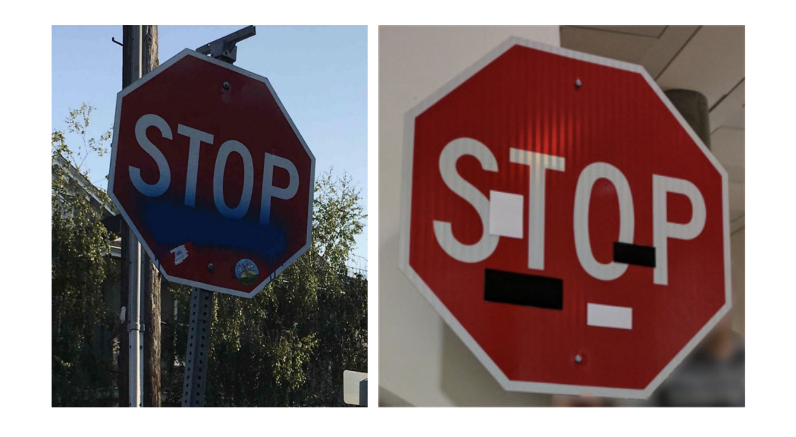
Translating Evasion attacks to the real world
Adversarial Patch Attacks
Computer Vision Adversarial Attack
Modifying digital examples is easy
Can we generate adversarial noise that translates when reproduced physically?
Minor modifications to adversarial evasion constraints can produce real world examples
Emphasize printability and object rotation/augmentation
Transfer Attacks often effective
Change a Stop sign to a Speed Limit Sign!
“Robust Physical-World Attacks on Deep Learning Visual Classification”, Eykholt et. al
https://arxiv.org/pdf/1707.08945.pdf

Slide 3
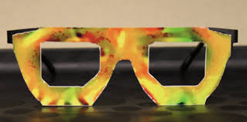
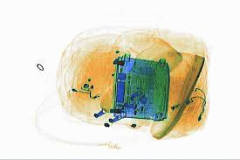
Adversarial Patch Threat
Potential threat outcomes
Untargeted attacks
Evade Perimeter Surveillance cameras
Evade Crowd Surveillance firearm detection
Evade X-ray scanning
Disrupt Maintenance Sensor Monitors
Targeted Attacks
Disrupt Targeting Systems
Cause Self Driving Car Misfunctions
Deceive Facial Recognition Algorithms
“Accessorize to a Crime: Real and Stealthy Attacks on State-of-the-Art Face Recognition”, Sharif et. al
https://www.cs.cmu.edu/~sbhagava/papers/face-rec-ccs16.pdf

Slide 4

Subverting Perimeter surveillance Demo
Notes:
Watching surveillance cameras at facilities is tedious, and requires a lot of eyes on the tv. As organizations turn to automation to

Slide 5
Surveillance Adversarial Patches – Real Scenario
Can you make a person invisible to cameras with an Adversarial Patches?
Researchers from Belgium attacked the popular yolo2 algorithm for object detection
First detects where there are objects, draws boxes around them
Secondarily classifies objects into categories like person, dog, bike
Objective is to defeat the first detection method, and fool the model into not registering any detections
Show how to develop defenses to make model more robust
Adversarial Training
“Fooling automated surveillance cameras: adversarial patches to attack person detection”, Thys et. al
https://arxiv.org/pdf/1904.08653.pdf

Slide 6
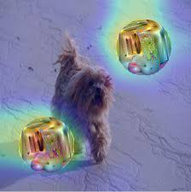
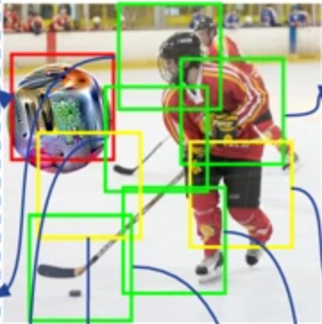
Defending against Adversarial Patches
Relatively New field, Not a ton of research Yet…
Input Transformation
Local Gradient Smoothing
Adversarial Training
Generalized robustness
Feature Explanability
Sentinet
Image Partitioning/Voting
Ally Patches
Model Re-Architecture
Interval Bound Propogation
Other untested Adversarial Evasion techniques
“Sentinet: Detecting physical attacks against Deep Learning Systems”, Chou et. al
https://arxiv.org/pdf/1812.00292.pdf
“Ally patches for spoliation of adversarial patches”, Abdel-Hakim et. al
https://journalofbigdata.springeropen.com/articles/10.1186/s40537-019-0213-4

Slide 7

Going forward
Prepare your AI attack surface
Know your models
Know you threat outcomes
Know the attacks you are vulnerable to
Know the defenses for those attacks
Notes:
So going forward we need to start preparing for attacks like this to become more common.
The repos are already out there to create the adversarial examples, now it’s just a matter of time before actors begin to use them for specific outcomes they want to achieve
Organizations can begin to get ready for this by know where they use AI, and their models, and determining the threat outcomes an actor could achieve if the could control the output of those models
Once we know what those are we can begin mapping out the attacks they would need in order to achieve their outcomes and install the proper adversarial defenses to prevent those attacks.

Slide 8
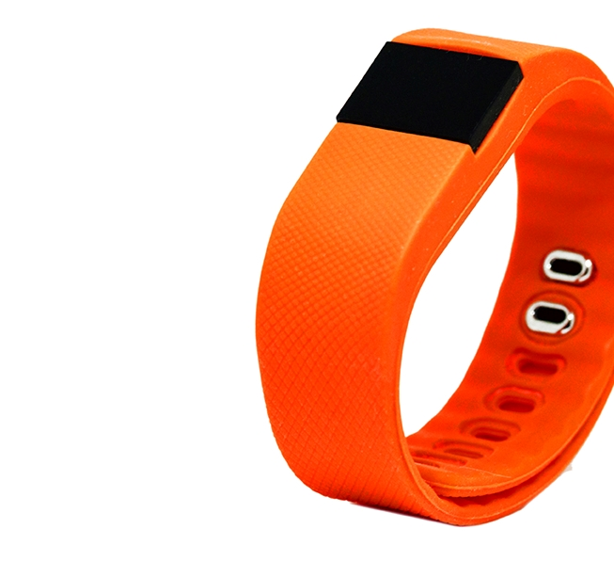
Questions/ Comments
Please Contact for more Information:
Iman Zabett – Data Scientist
Louis DiValentin – Data Scientist Manager

